Slide 1
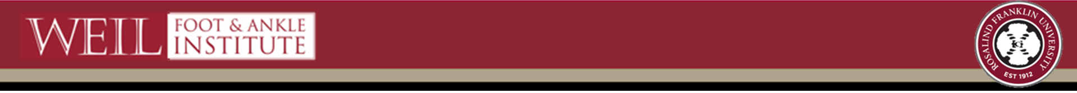

Cost-effectiveness of Routine Low Molecular Weight Heparin DVT Prophylaxis Following Select Foot and Ankle Surgeries
Adam Fleischer, DPM, MPH
Craig Wirt, PhD
Carolina Barbosa, PhD
Richmond Robinson, DPM
Arezou Amidi, DPM
Robert Joseph, DPM, PhD

Slide 2
Disclosures
This study received funding from American College of Foot and Ankle Surgeons (ACFAS).
ACFAS had no role in the design, conduct, or decision to publish.
Notes:
Cost-effectiveness, direct costs/expenditures and quality adjusted life years (QALYs)

Slide 3
Study Objective
To determine whether the decision to provide LMWH DVT prophylaxis (from a health system’s perspective) can be entirely explained by the type of foot/ankle surgery being performed
Notes:
Cost-effectiveness, direct costs/expenditures and quality adjusted life years (QALYs)

Slide 4
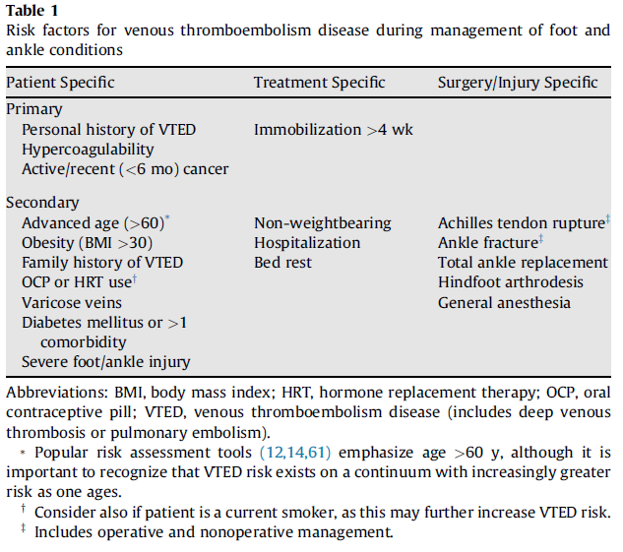
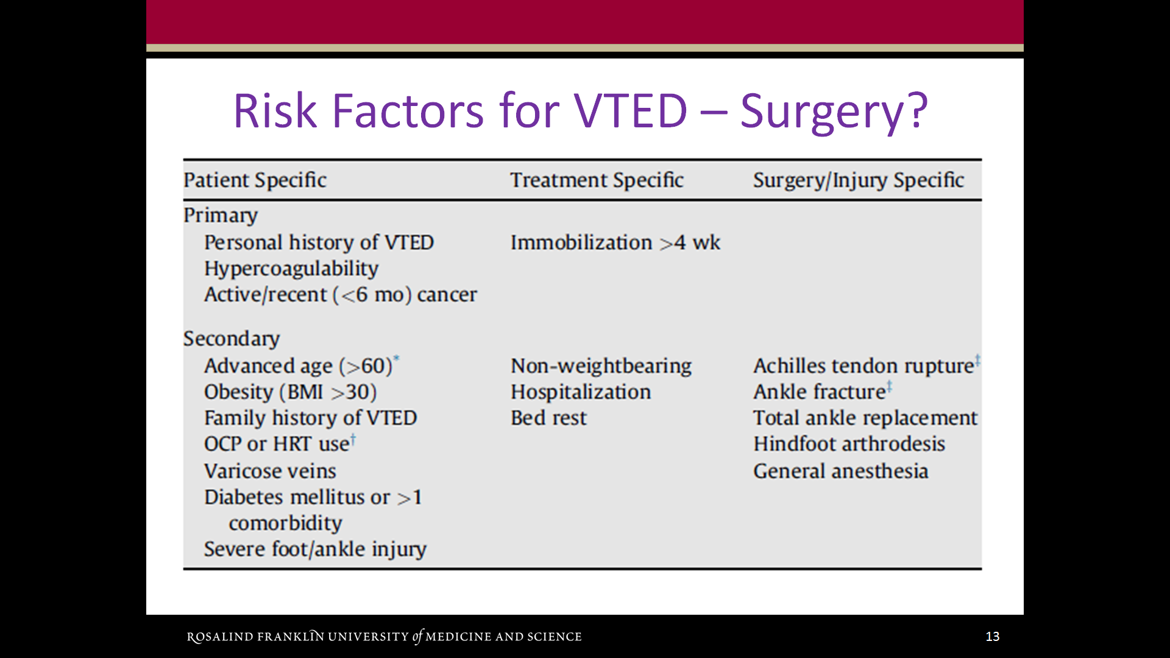
Risk Factors for VTED
Fleischer et al, J Foot Ankle Surg, 2015
Notes:
Demand LMWH consideration

Slide 5
Methods
Decision tree model (TreeAge Software, Inc.)
Compare health effects and costs of:
Prophylaxis w/ LMWH versus No prophylaxis
Five surgical scenarios: Achilles tendon repair (ATR), total ankle replacement (TAR), hallux valgus surgery (HVS), rearfoot arthrodesis (RFA), and ankle fracture surgery (AFS)
Outcomes = 1) short and long-term direct costs
2) quality adjusted life years (QALYs)
3) incremental cost per QALY gained (ICER)
Notes:
ICER reflects cost to achieve 1 additional QALY and is computed by dividing the difference in total costs by the difference in total QALYs associated with each strategy. Although no consensus has been reached in the US regarding ICERs, a $50,000 per QALY benchmark has been used in previous studies.

Slide 6
Methods
Estimates were retrieved from available literature, drug manuals, and CMS
Costs evaluated from the health care system perspective and expressed in 2015 U.S. dollars
Short-term results considered costs/outcomes through 1-year postoperative
Long-term results considered costs/outcomes over the lifetime of the individual
One-way sensitivity analyses performed
Notes:
Estimate for probabilities, QALY and direct costs were…
One way sensitivity analyses were conducted to estimate the impact on the results by changing key parameters individually. The analysis tested a range of value for all cost and utility parameters, and for some of the probabilities.

Slide 7
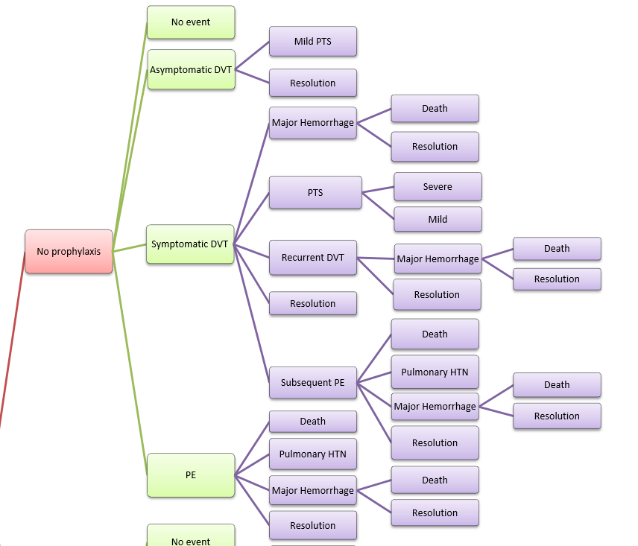
No Prophylaxis
Notes:
4 possible direct health effects

Slide 8
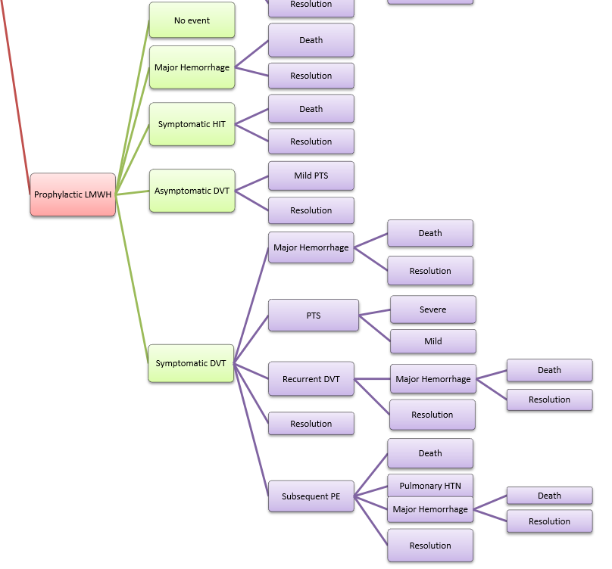
Prophylaxis
Notes:
5 possible direct health effects

Slide 9
Methods: Probability of Developing Asymptomatic DVT
Surgery | Chemical Prophylaxis | Probability of DVT
Achilles Tendon Repair | No | 0.247
Total Ankle Replacement | No | 0.259
Hallux Valgus Surgery | No | 0.021
Rearfoot Arthrodesis | No | 0.035
Ankle Fracture Surgery | No | 0.30
Surgery | Chemical Prophylaxis | Probability of DVT
Achilles Tendon Repair | Yes | 0.126
Total Ankle Replacement | Yes | 0.132
Hallux Valgus Surgery | Yes | 0.01
Rearfoot Arthrodesis | Yes | 0.018
Ankle Fracture Surgery | Yes | 0.15

Slide 10
Methods: Probability of Developing Symptomatic DVT
Surgery | Chemical Prophylaxis | Probability of DVT
Achilles Tendon Repair | No | 0.062
Total Ankle Replacement | No | 0.076
Hallux Valgus Surgery | No | 0.0001
Rearfoot Arthrodesis | No | 0.0003
Ankle Fracture Surgery | No | 0.026
Surgery | Chemical Prophylaxis | Probability of DVT
Achilles Tendon Repair | Yes | 0.032
Total Ankle Replacement | Yes | 0.039
Hallux Valgus Surgery | Yes | 0.00005
Rearfoot Arthrodesis | Yes | 0.00015
Ankle Fracture Surgery | Yes | 0.013

Slide 11
Methods: Probabilities not specific to surgery
Morbidity | Probability
Mild post thrombotic syndrome after asymptomatic DVT | 0.078
Post-thrombotic syndrome after symptomatic DVT | 0.214¹
Severe post-thrombotic syndrome | 0.081
Mild post-thrombotic syndrome | 0.133
Hemorrhage after symptomatic DVT management | 0.02
Hemorrhage after PE management | 0.041
Death after major hemorrhage | 0.148
Recurrent DVT after symptomatic DVT | 0.016
Morbidity | Probability
Hemorrhage after recurrent DVT | 0.013
PE after symptomatic DVT | 0.018
Pulmonary hypertension after PE | 0.013
Death from PE | 0.072
Hemorrhage with LMWH prophylaxis | 0.0027
HIT with LMWH prophylaxis | 0.0005^{2,3}
Death from HIT | 0.098
¹ Persson et al, J Thromb Haemost 2011
² McGarry and Thompson, Clin Ther 2004
³ Creekmore et al, Pharmacotherapy 2006

Slide 12
Methods: Estimated Direct Costs
Variable | Cost (US dollars)
Severe post-thrombotic syndrome | 6,870 (annually)
Mild post-thrombotic syndrome | 1,510 (annually) ¹
Symptomatic DVT | 6,836
Recurrent symptomatic DVT | 6,865
Uncontrolled hemorrhage | 10,950
Controllable hemorrhage | 7,311
PE | 24,787
Pulmonary HTN management | 27,365 (annually)
Prophylaxis with LMWH | 1,000 ²
HIT due to LMWH | 61,554 ^{3,4}
¹ Caprini et al, Value Health 2003
² http://www.goodrx.com/enoxaparin (retail)
³ McGarry and Thompson, Clin Ther 2004
⁴ Creekmore et al, Pharmacotherapy 2006

Slide 13
Methods: QALYs/Utility Values
Variable | Utility Value
Health utility of general population | 0.870¹
QALY severe PTS | 0.818
QALY mild PTS | 0.853
QALY pulmonary HTN | 0.710²
QALY after PE resolution | 0.852
QALY after DVT resolution | 0.856
QALY after hemorrhage resolution | 0.864³
QALY after HIT resolution | 0.852
¹ Luo et al, Med Care 2005
² Shafazand et al, Chest 2004
³ Hogg et al, JAMA Intern med 2013

Slide 14
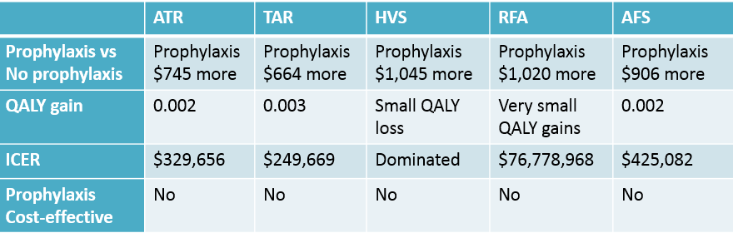
Results
Short-term analysis
Notes:
Routine LMWH prophylaxis was always associated with greater costs compared to no prophylaxis
and prophylaxis was associated with only minimal gains in QALY resulting in exceedingly high ICERs associated with a routine prophylaxis strategy.
For HVS prophylxais cost more at one year AND lower health outcomes

Slide 15
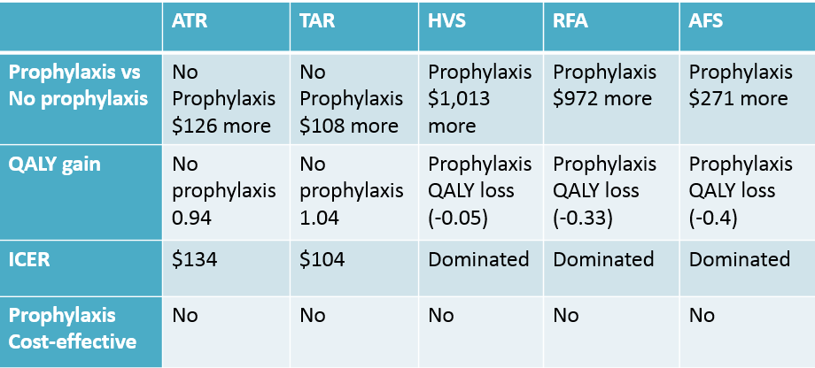
Results
Long-term/Lifetime analysis
Notes:
Over the lifetime of the individual, for 2 surgeries ATR and TAR, No prophylaxis resulted slightly more costs (about $100), but the strategy was associated with significant gains in health outcomes, near 1 whole QALY, This is reflected in the low ICERs associated with no prophylaxis
The other surgeries were associated with BOTH greater costs with prophylaxis AND worse health outcomes (losses in QALY)
Hence, like in the short term analysis, LMWH was not found to be cost effective for any foot/ankle surgery in the long term analysis either

Slide 16
Results: Sensitivity Analysis
Short-term analysis
  Cost of LMWH was only variable found to impact results
    * ATR and TAR: LMWH < $400 may become cost-effective
    * AFS: LMWH < $100 AFS may become cost-effective
  RFA and HVS: results were robust to all sensitivity analyses; there were no circumstances under which prophylaxis was cost-effective for RFA and HVS
Tornado Analysis (ICER)
ATR - Short Term
Long-term analysis
  For all surgeries: results were robust to all sensitivity analyses; there were no circumstances under which prophylaxis was cost-effective when long-term costs and effects were taken into account
Notes:
One way sensitivity analyses were conducted to estimate the impact on the results by changing key parameters individually. The analysis tested a range of value for all cost and utility parameters, and for some of the probabilities

Slide 17
Conclusions
Even when assuming maximal efficacy and minimal harm with LMWH use, we did not find any foot/ankle surgery where routine prophylaxis would be preferred.
For RFA, AFS and HVS routine LMWH prophylaxis may be associated with both greater costs and worse health outcomes over the lifetime of the individual.
Notes:
Maximal benefit and least harm with LMWH
→ both the asymptomatic and symptomatic DVT rate reduced by 0.51 with LMWH use (Testroote et al, Cochrane Database Syst Rev, 2014)
→ the PE rate reduced to 0 (Testroote et al, Cochrane Database Syst Rev, 2014)
→ assumed the fewest possible side effects resulting from LMWH use, using the lowest reported rates of HIT and major hemorrhage from the literature, and did not consider the negative health effects and costs associated with minor hemorrhage

Slide 18
Risk Factors for VTED
Fleischer et al, J Foot Ankle Surg, 2015
Notes:
Unlike hip and knee replacement surgery, the decision to use LMWH prophylaxis should not be based solely on the type of foot/ankle surgery planned. Patient-specific risk factors (age, history of VTED) will continue to drive the decision to provide chemical prophylaxis or not.

Slide 19
Thank You
Adam Fleischer, DPM, MPH
Associate Professor
Dr. William M. Scholl College of Podiatric Medicine
adam.fleischer@rosalindfranklin.edu
Director of Research
Weil Foot and Ankle Institute
aef@weil4feet.com

