Slide 1
Elder Abuse:
The Podiatric Medical Assistant’s Role in Caring for our Most Vulnerable Patients
Susan M. Weeks, PMAC
Midwest Podiatry Conference
Chicago, Illinois
April, 2017

Slide 2

What is abuse?
As a verb: to treat a person with cruelty or violence especially regularly or repeatedly
As a noun: cruel or violent treatment of a person

Slide 3
A Description of Seven Different Types of Elder Abuse
Source: the peck group legal blog

Slide 4
Physical Abuse: use of physical force that may result in bodily injury
physical pain or impairment
Sexual Abuse: non-consensual sexual contact of any kind
Emotional Abuse: Infliction of anguish, pain or distress through verbal or non-verbal acts
Financial/Material Exploitation: Illegal or improper use of an elder’s funds, property or assets
Neglect: Refusal or failure to fulfill any part of a person’s obligation or duties to an elderly person
Abandonment: Desertion o an elderly person by an individual who has physical custody of the elder or by a person who has assumed responsibility for providing care to the elder
Self-neglect: Behaviors of an elderly person that threaten the elder’s health or safety

Slide 5
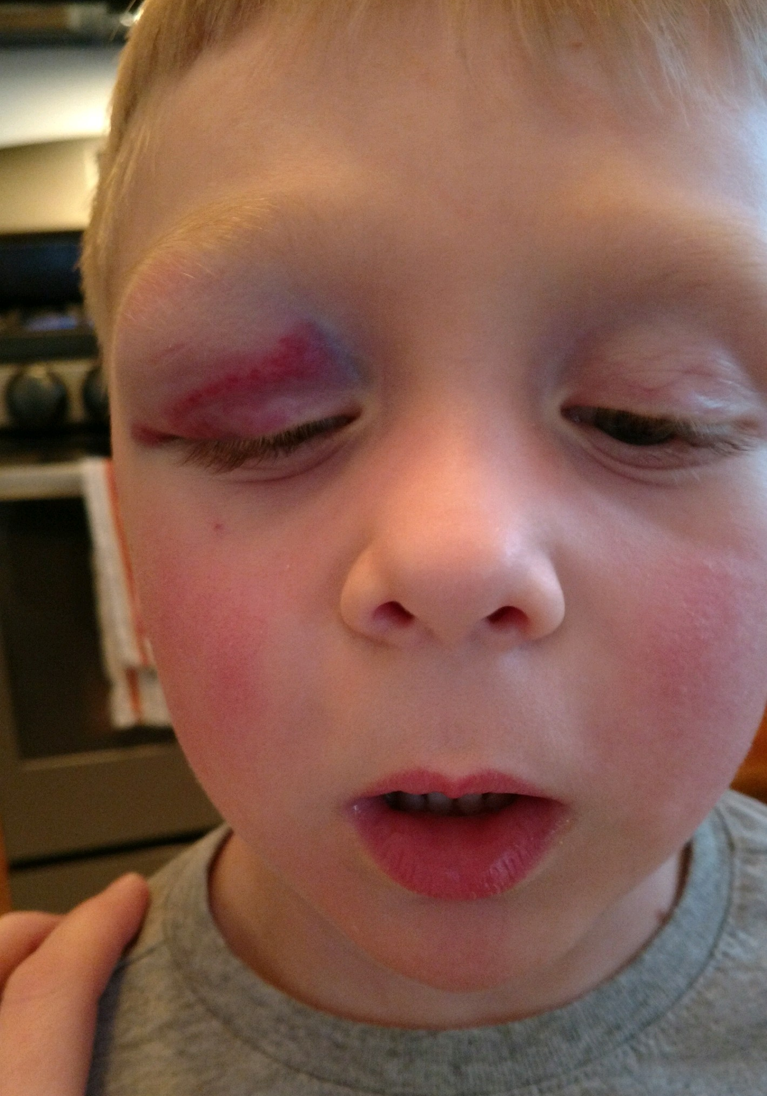
Obvious Injury
This child was NOT abused…this is a classic playground injury-2 four year old noggins colliding

Slide 6
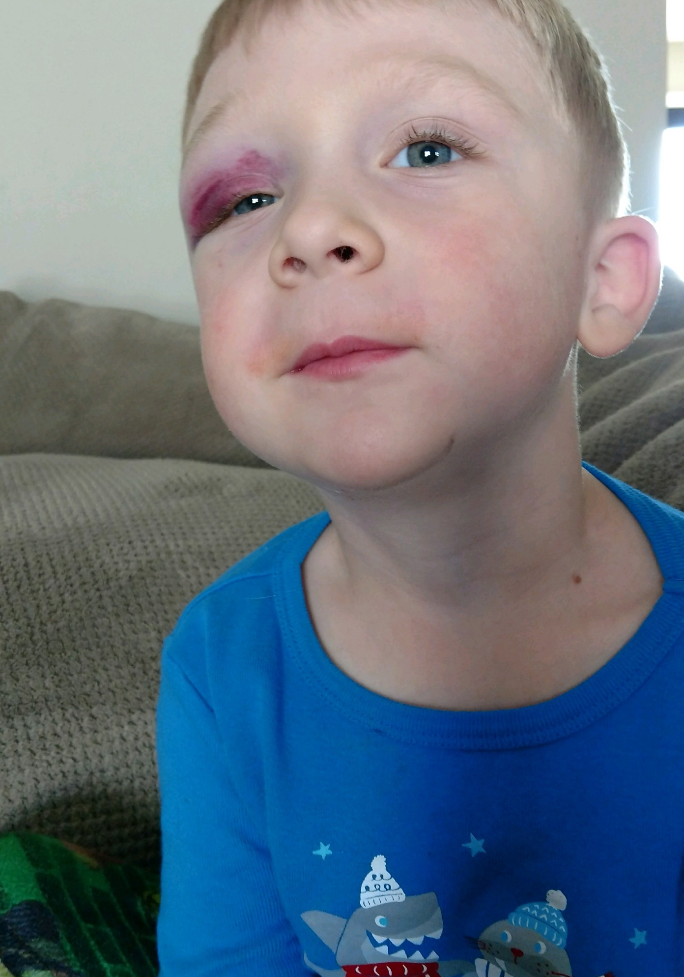
No Children Were Harmed in the Production of this Power Point Presentation
And the laws of physics dictate this black eye will take weeks to heal

Slide 7
Physical Abuse in the Elderly
It would be fairly rare to see physical injury to a patient
Appearance of significant bruising in the elderly can be a result of medications-especially blood thinners
Scratches can be caused by pets and be severe due to neuropathy
What should you do?
  Document /photograph and discuss with patient and/or caregiver

Slide 8
Sexual Abuse in the Elderly
May be more prevalent in patients that come from nursing homes
Due to podiatry scope of practice may only be uncovered as other abuse allegations are investigated

Slide 9
Emotional Abuse in the Elderly
Abused patient may be accompanied by ‘caregiver’ who is demanding of doctor and staff-claiming to do so in the best interest of the patient
  Why does my mother have to wait so long?
  Your prices are too high…you’re just cutting her toenails
Abused patient may not be allowed to speak for herself
What can you do?
  Listen for clues
  Engage the patient, speak softly, use direct eye contact

Slide 10
Financial/Material Exploitation of the Elderly

Slide 11
Neglect of the Elderly

Slide 12
Abandonment of the Elderly

Slide 13
Self Neglect in the Elderly

Slide 14
Section Navigation
Protection & Advocacy
Currently selected
Adult Protective Services
APS Statistics
Elder Rights
Legal Assistance
Long Term-Care Ombudsman Program
Looking Out for Fraud
Prevention and Awareness
Publications
Report Abuse

Slide 15
Clerk of the Circuit Court
Cook County, Illinois
Welcome to the Senior Citizens Resource Guide
The Senior Citizen Resource Guide provides access to information about services that may be of interest to seniors. This page offers referrals to legal and self representative (Pro Se) assistance available throughout Cook County, and provides links to other governmental entities that provide services relevant to seniors.
Effective January 2, 2015, the Clerk of Court implemented the Elder law & Miscellaneous Remedies (ELMR) Division Case Filing Program. The Elder Law and Miscellaneous Remedies (ELMR) Division hears matters that involve litigants age 60 and older pertaining to the Adult Protection Services Act; the Illinois Power of Attorney Act; Domestic Violence offenses and certain criminal offenses in which the victim is age 60 or older. ELMR judges and courtroom staff are trained to be sensitive to the vulnerability of elderly litigants and to identify underlying issues and concerns. Click here for more information.
Honorable Patricia Banks, Circuit Judge, Presiding Judge
Elder Law & Miscellaneous Remedies Division
About the Honorable Patricia Banks
About the Elder Law Miscellaneous Remedies Division

Slide 16
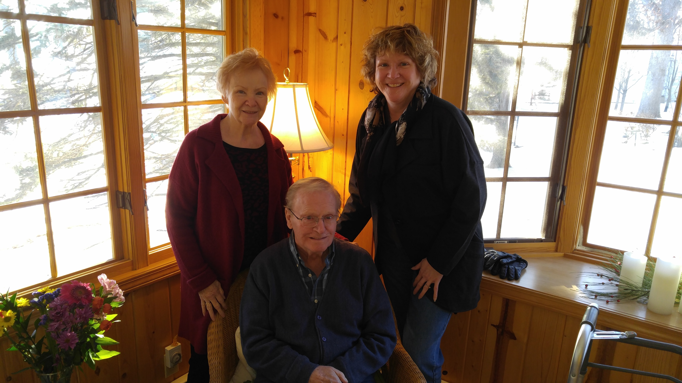
My Two Favorite Seniors

